Slide 1
Chapter 3 : Computer Ethics and Ethical Theories
Philosophical and Professional Ethics
Moral and Legal Issues
Descriptive and Normative Claims
Ethical Relativism
Utilitarianism and Deontological Theories
Rights

Slide 2
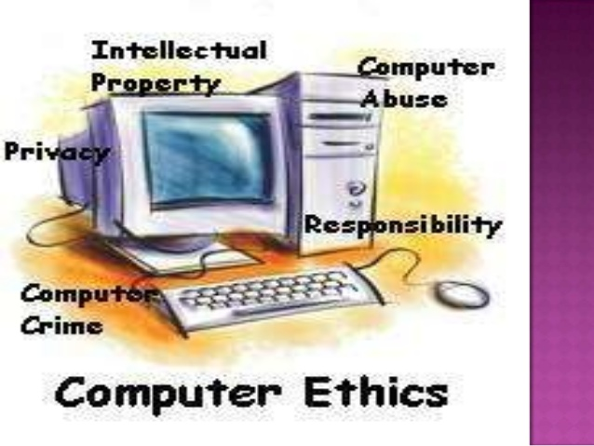
Computer Ethics

Slide 3
Computer Ethics
“Ethics is a set of moral principles that govern the behavior of a group or individual.”
Computer ethics is a branch of philosophy that deals with computing-related moral dilemmas
defines ethical principles for computer professionals
professionals must try to avoid unethical behavior

Slide 4
Computer Ethics
Today there are numerous illegal and unethical actions that can arise through computer usage
Plagiarism and copyright infringement
Software Piracy
Computer crimes, unauthorized computer access
Intellectual Property
Professional Responsibility

Slide 5
Computer Ethics
The Ten Commandments of Computer Ethics
Thou shalt not use a computer to harm other people.
Thou shalt not interfere with other people's computer work.
Thou shalt not snoop around in other people's computer files.
Thou shalt not use a computer to steal.
Thou shalt not use a computer to bear false witness.

Slide 6
Computer Ethics
The Ten Commandments of Computer Ethics(contd…)
Thou shalt not copy or use proprietary software for which you have not paid (without permission).
Thou shalt not use other people's computer resources without authorization or proper compensation.
Thou shalt not appropriate other people's intellectual output.
Thou shalt think about the social consequences of the program you are writing or the system you are designing.
Thou shalt always use a computer in ways that ensure consideration and respect for other humans.

Slide 7
Ethical Theories
Ethics: A theory or system dealing with values relating to human conduct, with respect to the rightness and wrongness of certain actions and to the goodness and badness of the motives and ends of such actions.
Ethical theory is the systematic effort to understand moral concepts and justify moral principles and theories.

Slide 8
Philosophical and Professional Ethics
Philosophical Ethics
Philosophical ethics is the rational study of the meaning and justification of moral claims.
A moral claim evaluates the rightness or wrongness of an action or a person’s character.
For example, “Lying is wrong” claims the act of lying is wrong, while “One shouldn’t be lazy” claims a character trait (i.e., laziness) is wrong.
Philosophical ethics is usually divided into two distinct subject areas: metaethics and normative ethics.

Slide 9
Philosophical and Professional Ethics
Normative ethics
Reflects ordinary view that somethings are better than others
Examines moral standards that attempt to define right and wrong
Examining good and bad habits, duties or an action’s consequences
Ask questions like
How should the moral person behave?
What has Moral?
What are our moral obligations?

Slide 10
Philosophical and Professional Ethics
Metaethics
Examines nature of moral claims and standards
It is not concerned with discovering what is right action is or how to become moral.
Rather it ask philosophical questions about ethics.
Ask questions like
What is morality?
What is the nature of morality?
Where they came from?

Slide 11
Philosophical and Professional Ethics
Professional Ethics
Professional ethics are principles that govern the behavior of a person or group in a business environment.
Like values, professional ethics provide rules on how a person should act towards other people and institutions in such an environment.
Unlike values, professional ethics are often codified as a set of rules, which a particular group of people use.
This means that all those in a particular group will use the same professional ethics, even though their values may be unique to each person.

Slide 12
Philosophical and Professional Ethics
There are some universal ethical principles that apply across all professions, including:
honesty
trustworthiness
loyalty
respect for others
adherence to the law
doing good and avoiding harm to others
accountability

Slide 13
Moral and Legal Issues
A LEGAL issue is serious and is against the law. This would be illegal and prosecution would follow with the possibility of a fine or imprisonment.
A MORAL issue would be regarded by most people as wrong but doesn’t necessarily break any laws.

Slide 14
Moral and Legal Issues
Disinformation Trying to mislead or give false information. Can be a LEGAL and MORAL issue.
Example
MORAL ISSUE
Television salesperson advising you to buy a particular model of TV because he will get better commission for this model and he knows that a newer model will be released within a few weeks.
LEGAL ISSUE
Television salesperson selling you a TV by claiming the TV is 3D and it is not, he would be breaking the Trade Description Act

Slide 15
Moral and Legal Issues
Privacy The rights of individuals to keep information about themselves private. The Data Protection Act does this but there are some situations where the Act does not protect the individual.
Example
MORAL ISSUE
Company buying information off other companies in order to send you junk mail about buying products.
LEGAL ISSUE
Selling on details of individuals even though they have clearly specified that this should not be done. Breaches the Data Protection Act.

Slide 16
Moral and Legal Issues
Intellectual Property Rights People can protect their work and make it illegal for other people to copy or use their work without their permission.
Example
MORAL ISSUE
Discussing an idea with a friend, and developing the idea as your own.
LEGAL ISSUE
A company taking someone's work and using it as their own for a financial gain; plagiarism and fraud.

Slide 17
Descriptive and Normative Claims
Claim..?
A “claim” is statement that asserts something that could be either true or false.
A claim is a statement that needs to be proven or supported and can be done through arguments.
Example:
KP Oli is the greatest PM of Nepal.
Kathmandu is capital of Nepal.
The sky is beautiful.

Slide 18
Descriptive and Normative Claims
Descriptive Claim
A descriptive claim is a claim that asserts that such-and-such IS the case.
A statement that describes something.
Express an understanding of How something is or could be.
No evaluation, don’t involve value judgement
Example: nast.edu.np is a website. The trueness or falseness claim can be determine without involving values. Just go to nast.edu.np.

Slide 19
Descriptive and Normative Claims
Examples of descriptive claims:
The mug of coffee in front of me is now at room temperature.”
“I had toast and eggs for breakfast this morning.”
“Kevin is under six feet tall.”
These are all descriptive claims. They make no value judgments.

Slide 20
Descriptive and Normative Claims
Normative Claim
A NORMATIVE claim, on the other hand, is a claim that asserts that such-and-such OUGHT to be the case.
A statement that express evaluation of something.
Makes an evaluation relative to something else
involve value judgement
Example: nast.edu.np is a good website. It involves value.

Slide 21
Descriptive and Normative Claims
Examples of normative claims:
PUBG is a better game than Call of Duty.
“That was a really stupid thing to do.”
“If you wanted to pass the exam you should study harder.”
“The State should not have the right to take the life of one of its citizens as punishment for a crime.”
These are all normative claims. Each one of them expresses a value judgment of some kind.

Slide 22
Ethical Relativism
Ethical relativism is the theory that holds that morality is relative to the norms of one's culture.
That is, whether an action is right or wrong depends on the moral norms of the society in which it is practiced.
The same action may be morally right in one society but be morally wrong in another.
Ethical relativism holds that there are no universally valid moral principles,
but rather all moral principles are valid relative to culture or individual.

Slide 23
Ethical Relativism
Two Forms of Ethical Relativism:
1. Cultural (social) relativism—What is right or wrong may vary fundamentally from one society/culture to another but is the same for people of the same society/culture
2. Extreme (individual) relativism—What is right or wrong may vary fundamentally from one person to another even within the same society/culture.

Slide 24
Ethical Relativism
Example:
Moral in USA | Immoral in
Eating Beef | India
Drinking alcohol, Gambling | Middle Eastern Islamic Countries
Women in school or business | Afghanistan
Women wearing shorts, face uncovered | Iran, Saudi Arabia, Sudan
Immoral in USA | Moral or Acceptable
Killing newborn females | China, India
Family kills a woman family member who is raped | Somalia, Sudan

Slide 25
Ethical Relativism
One advantage of ethical relativism is that it allows for a wide variety of cultures and practices. It also allows people to adapt ethically as the culture, knowledge, and technology change in society. This is a good and valid form of relativism.
The disadvantage of ethical relativism is that truth, right and wrong, and justice are all relative. Just because a group of people think that something is right does not make it so. Slavery is a good example of this. Two hundred years ago in America, slavery was the norm and morally acceptable. Now it is not.

Slide 26
Utilitarianism and Deontological Theories
Utilitarianism: (Jeremy Bentham)
Utilitarianism is an ethical theory that determines right from wrong by focusing on outcomes.
It is a form of consequentialism.
Utilitarianism holds that the most ethical choice is the one that will produce the greatest good for the greatest number.
It is the only moral framework that can be used to justify military force or war.

Slide 27
Utilitarianism and Deontological Theories
Utilitarianism:
However, because we cannot predict the future,
It’s difficult to know with certainty whether the consequences of our actions will be good or bad. This is one of the limitations of utilitarianism.
Utilitarianism also has trouble accounting for values such as justice and individual rights.
For example, assume a hospital has four people whose lives depend upon receiving organ transplants: a heart, lungs, a kidney, and a liver. If a healthy person wanders into the hospital, his organs could be harvested to save four lives at the expense of one life. This would arguably produce the greatest good for the greatest number. But few would consider it an acceptable course of action, let alone the most ethical one.

Slide 28
Utilitarianism and Deontological Theories
Deontological ethics: (Immanuel Kant)
The word “deontological ” comes from a Greek word “deon” which means “binding duty”.
Actions that obey these rules are ethical, while actions that do not, are not.
Deontology is a theory that suggests actions are good or bad according to a clear set of rules.
Deontological ethics is an ethics system that judges whether an action is right or wrong based on a moral code.

Slide 29
Utilitarianism and Deontological Theories
Deontological ethics: (Immanuel Kant)
Consequences of those actions are not taken into consideration.
Doing the right thing means to follow proper rules of behavior and, by doing so, promoting fairness and equality.
An example of deontology is the belief that killing someone is wrong, even if it was in self-defense.

Slide 30
Utilitarianism and Deontological Theories
To better understand deontology vs utilitarianism, let’s use an example that features a moral dilemma.
Peter is a father and his son is very sick. Peter took his son to the doctor and found out that his son needs a very expensive surgery. Peter doesn’t have enough time to earn the money needed for the surgery because his son is in a critical condition. Peter, not knowing what to do to save his son, decides to lie. Peter goes to a bank and asks for a personal loan intended to be for investing in a new business that would generate a lot of revenue. Peter gets the money, goes to the hospital, pays for the surgery and saves his son’s life.

Slide 31
Utilitarianism and Deontological Theories
To better understand deontology vs utilitarianism, let’s use an example that features a moral dilemma.
According to Kant, Peter shouldn’t have lied. According to Bentham, Peter did the right thing because, at the end, he saved a life. According to you, what have you done if lying would have been your only choice to save a life?
As we can see with this example, ethical dilemmas are not easy to solve. Ethics depend on a moral framework. We make decisions based on what we believe is right and what is best for us, but not necessarily for everyone else. In some situations, we decide with our hearts, in other situations with our brains. Being human is part of the dilemma.

Slide 32
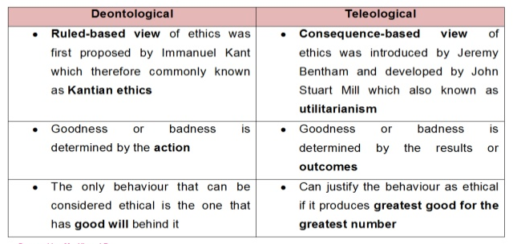
Utilitarianism and Deontological Theories

Slide 33
Rights
Rights are legal, social, or ethical principles of freedom or entitlement; that is, rights are the fundamental normative rules about what is allowed of people or owed to people according to some legal system, social convention, or ethical theory.
Rights are those important conditions of social life without which no person can generally realize his best self.
These are the essential conditions for health of both the individual and his society

Slide 34
Rights
Main features of Rights:
Rights exist only in society. These are the products of social living.
Rights are claims of the individuals for their development in society.
Rights are recognized by the society as common claims of all the people.
Rights are rational and moral claims that the people make on their society.
Since rights are here only in society, these cannot be exercised against the society.
Rights are equally available to all the people.

Slide 35
Rights
Types of Rights:
1. Natural Rights
-the right to life, right to liberty
2. Moral Rights
-rules of good conduct, moral behavior
3. Legal Rights
-civil rights, political rights and economic rights
4. Human Rights
- right to work and education
5. Contractual Rights:
-Rights to purchase a particular product or service
-Rights to be sell a product or service

Slide 36
Thank You

